Slide 1

Bank Loan Case Study Excel file: https://docs.google.com/spreadsheets/d/1W6b2gRz5BzHGOllMOtklkHad8G7W_12S/edit?usp=sharing&ouid=100909624457952493190&rtpof=true&sd=true
BY
CHANDRU SAMBATH

Slide 2

Description:
This case study aims to give you an idea of applying EDA in a real business scenario. In this case study, apart from applying the techniques that you have learnt in the EDA module, you will also develop a basic understanding of risk analytics in banking and financial services and understand how data is used to minimize the risk of losing money while lending to customers.
When the company receives a loan application, the company has to decide for loan approval based on the applicant’s profile. Two types of risks are associated with the bank’s decision:
If the applicant is likely to repay the loan, then not approving the loan results in a loss of business to the company.
If the applicant is not likely to repay the loan, i.e. he/she is likely to default, then approving the loan may lead to a financial loss for the company.

Slide 3

Approach
Download and Data open in excel
Find null and duplicate values and clean all data
Data processing and solved as per asked problems.
Use filter pivot table and other functions to give answer the asked questions.
Create charts to for easy and meaningful data representation
Create report in ppt format and submit the project

Slide 4

Tech-Stack Used
Microsoft Excel
Resources used MS Excel Dataset provided (Bank loan case study) (https://drive.google.com/drive/folders/1Mcvc5tJGvgJK8UetCtY1VnMYoVOMzaAe )

Slide 5
Solution
I used COUNTA function to count the total rows in each columns/variables. Then found the percentage of null values in each columns by using formula - (Total rows count for each column / Total rows count) * 100.
After that, I removed the columns whose percentage of null value is greater than 30% and the columns having percentage of null value is less than 30%perform the distribution statistics i.e., mean and mode to find the missing values in a cell.
I kept only relevant variables to get the insights from it and converted the days in years divided by 365.
I also found the outliers with the help of inter quartile range method considering relevant variables.

Slide 6
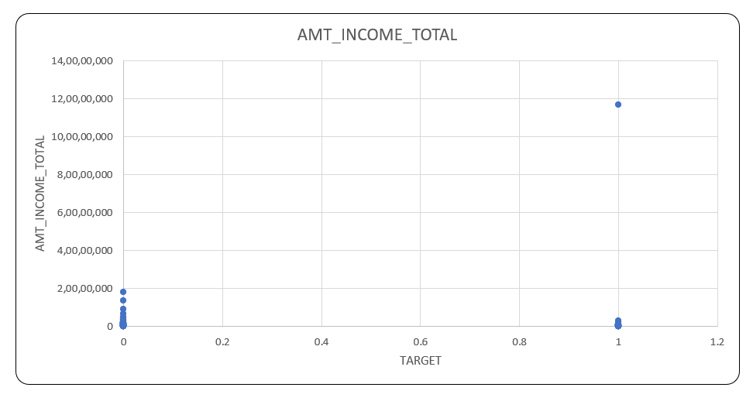
OUTLIER
In this XY plotter, we can see that for the target variable 1 there are few applicants who draw an income of 11 crores whereas majority of the applicants drawing an income in lacs only

Slide 7
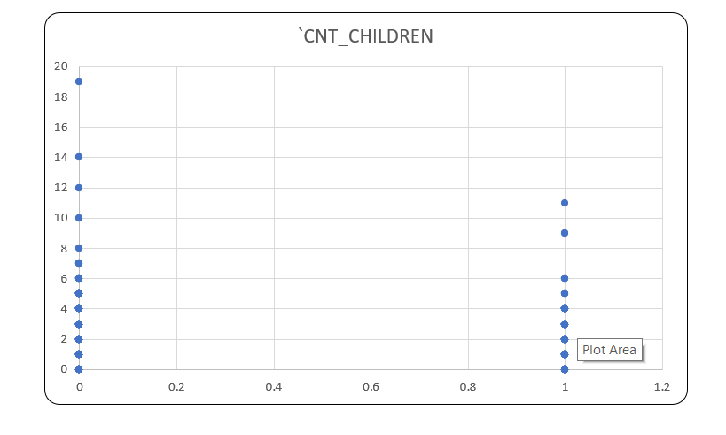
OUTLIER
In this XY plotter, we can see that for the target variable 0 applicants having max 19 Childrens which is highly unusual in these days whereas target 1 applicants having max 11 Childrens only.

Slide 8
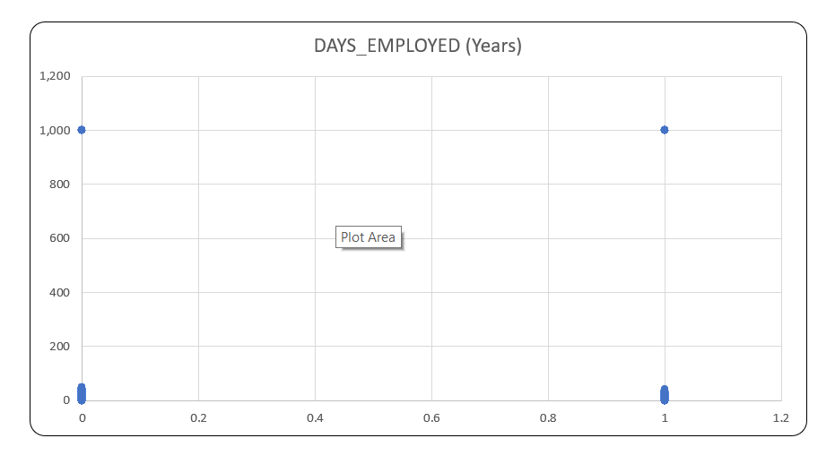
OUTLIER
In this XY plotter, we can see that there are few applicants in target 0 & 1 were employed for 1000 years which is impossible whereas as majority of the applicants are employed for around 80-90 years.

Slide 9
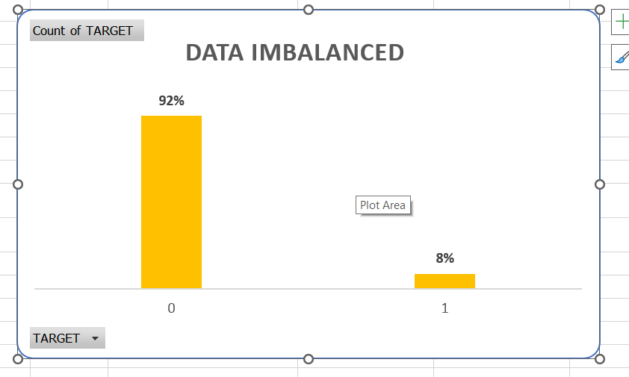
Data Imbalance
The above attached excel file, in data imbalanced sheet show the ratio of total applicants with payment difficulties i.e., target 1 to the total applicants with payment made on time i.e., target 0 is 11:39.
Out of total applicants of 307511, the percentage of applicants which makes payment on time is 92% thus makes a majority class whereas the percentage of applicants with payment difficulties is 8% thus makes a minority class.

Slide 10
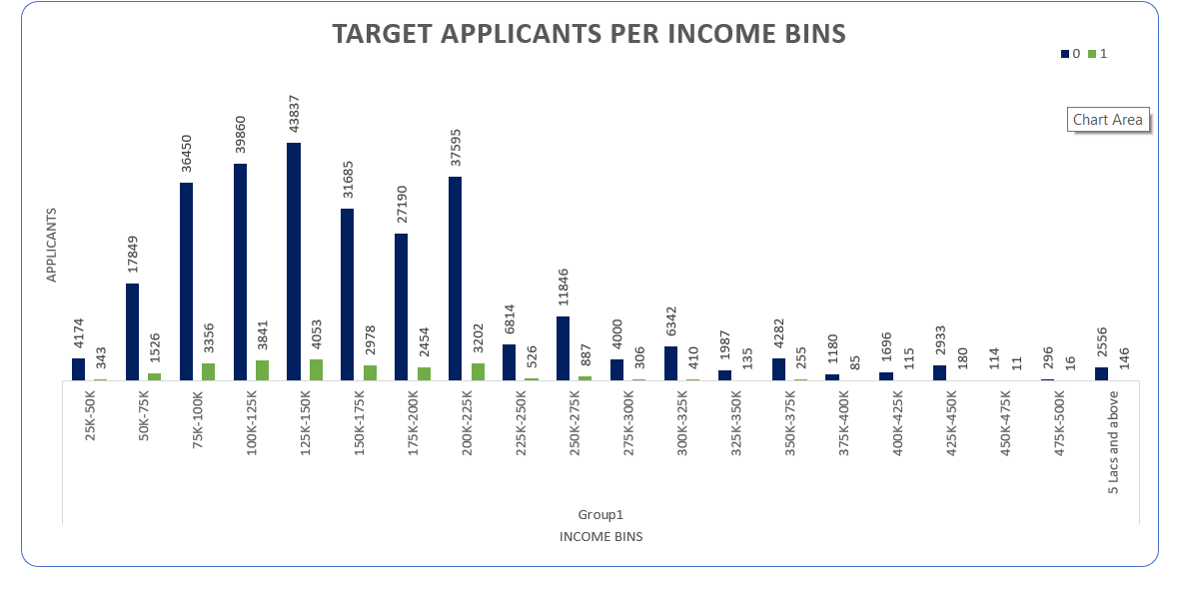
Segmented Univariate Analysis

Slide 11
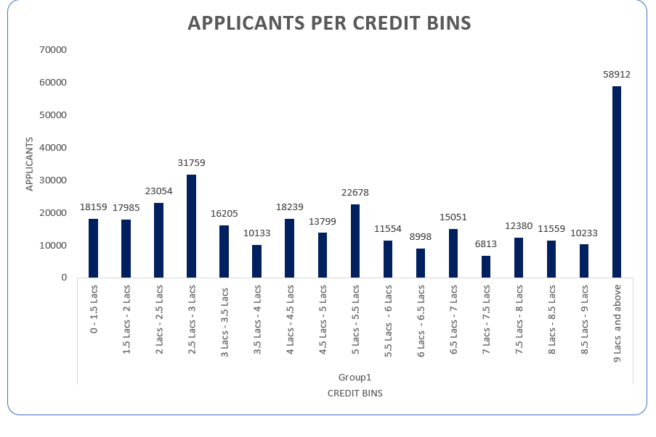
Univariate analysis

Slide 12
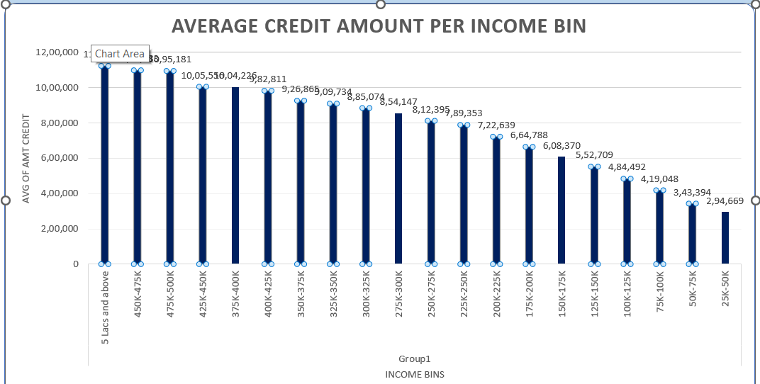
Bivariate Analysis

Slide 13
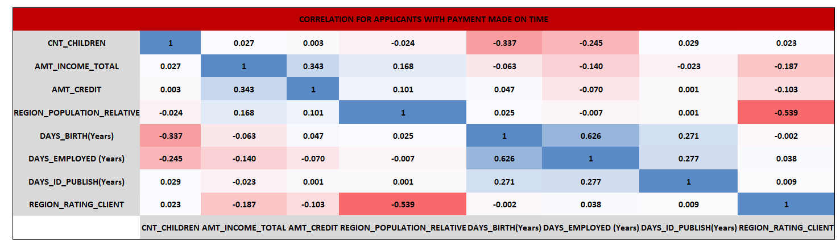
CORRELATION FOR APPLICANTS WITH PAYMENT MADE ON TIME

Slide 14
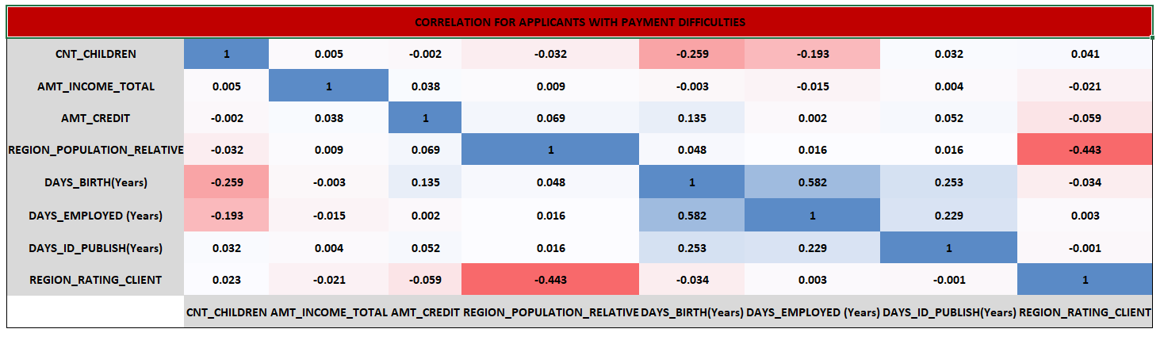
CORRELATION FOR APPLICANTS WITH PAYMENT DIFFICULTIES

Slide 15
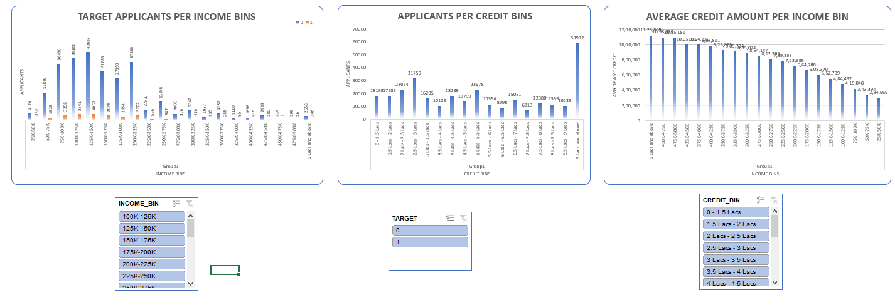
Dashboard

Slide 16

Result
It shows that higher Income were offered the higher credit amount.
1
Majority of the applicants got loan approval of credit range 9 lacs and above.
2
Most of the applicants (0&1) drawing an income between 1lacs - 2.25 lacs.
3

Slide 17

Excel File:
https://docs.google.com/spreadsheets/d/1W6b2gRz5BzHGOllMOtklkHad8G7W_12S/edit?usp=sharing&ouid=100909624457952493190&rtpof=true&sd=true

